Slide 1
Quantum Mechanics
<number>

Slide 2
The Wave Function
<number>
Notes:
<number>

Slide 3
The Wave Function
The configuration or state of a quantum object is completely specified by the wave function.
The wave function of a particle, at a particular time, contains all the information that anybody at that time can have about the particle (e.g. position, momentum, and energy).
The wave function, in general, is not a real quantity, but a complex-valued functions of space and time.
<number>
Notes:
<number>

Slide 4


The Wave Function
In one dimension the wave function is denoted by ψ(x, t), while in three dimension it is ψ(x, y, z, t).
How do we get the wave function?
The wave function is derived by solving Schrödinger equation.
<number>
Notes:
<number>

Slide 5
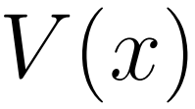
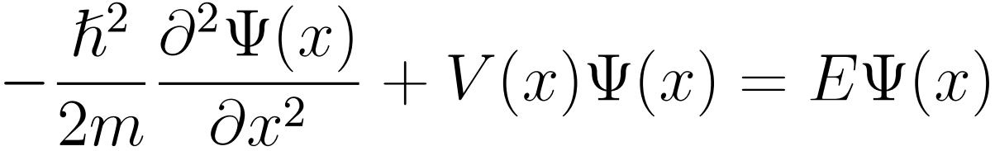
The Wave Function
The Schrödinger equation of the particle moving in the potential is written as
<number>
Notes:
<number>

Slide 6
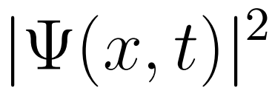

The Wave Function
The wave function itself has no physical interpretation.
It is not measurable.
The square of the absolute value of the wave function has a physical interpretation.
In one dimension, we interpret |ψ(x,t)|^2 as a probability density, a probability per unit length of finding the particle at a time t at position x .
<number>
Notes:
<number>

Slide 7
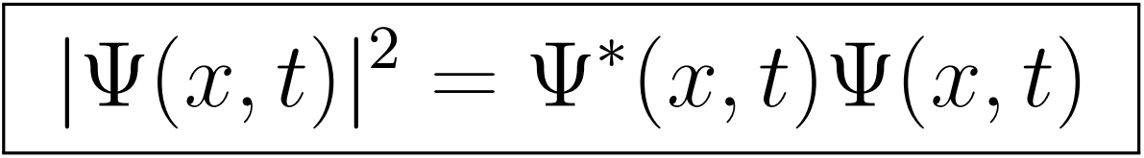
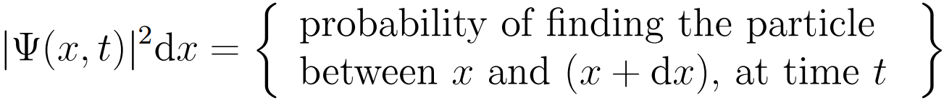
The Wave Function
Since the wave function, in general, is a complex function we write
<number>
Notes:
<number>

Slide 8
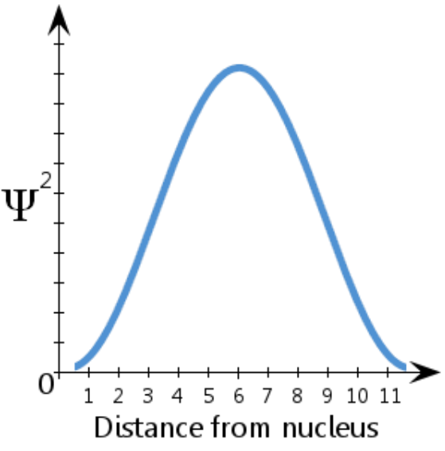
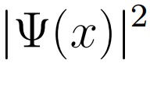

The Wave Function
A (fictitious) schematic diagram showing Ψ² against distance from nucleus, in arbitrary unit.
There is a 100% probability that the electron is somewhere - in other words a probability of 1.
<number>
Notes:
For example, in the (fictitious) schematic diagram plotted here, showing Ψ² against distance from nucleus, we see that the electron is most likely to be found between about 5-7 units from the nucleus. We also see that there is a vanishingly small likelihood that the electron will be at the nucleus or more than about 11½ units away from the nucleus.
There is a 100 percent probability that the electron is somewhere - in other words a probability of 1.
<number>

Slide 9
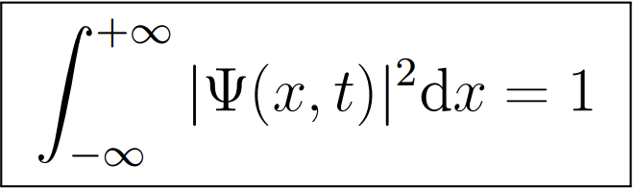
The Wave Function
The normalization condition of the wave function
The wave function must be single valued and continuous.
<number>
Notes:
<number>

Slide 10
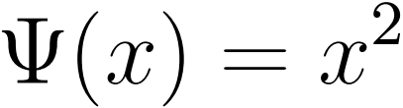
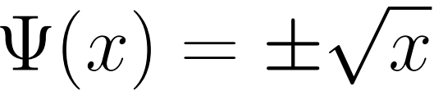
The Wave Function
Single-valued wave function:
Multi-valued wave function:
<number>

Slide 11
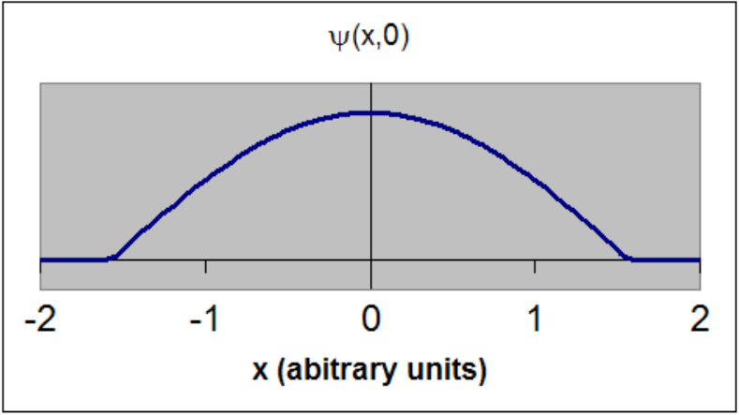
The Wave Function
This is an acceptable wave function.
It is single valued and continuous.
<number>
Notes:
<number>

Slide 12
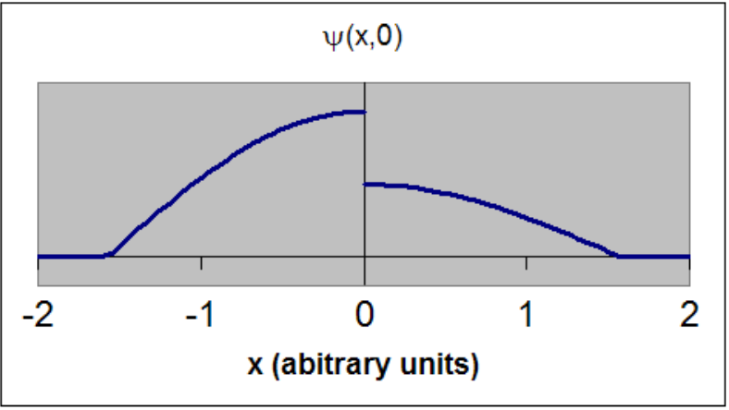
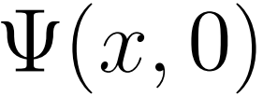

The Wave Function
This is an unacceptable wave function. ψ(x,0) does not have a unique single value at x = 0 . The wave function is not continuous.
<number>
Notes:
<number>

Slide 13
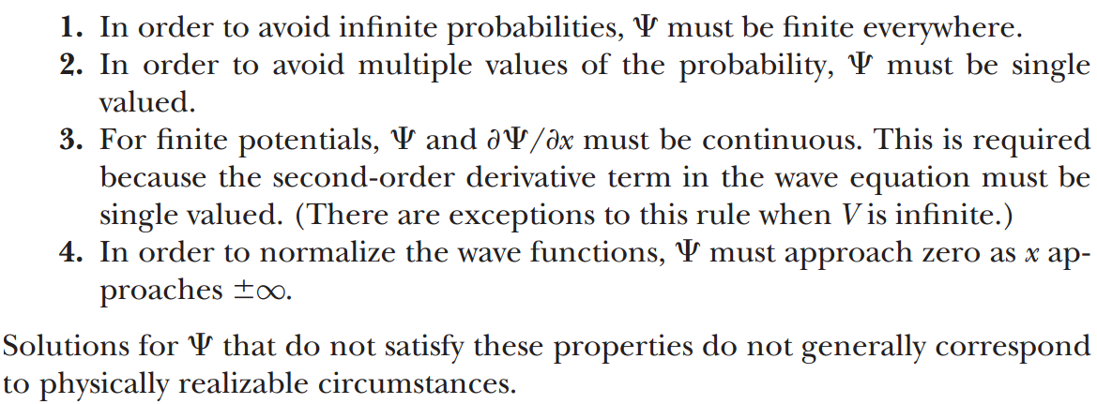
The Wave Function
<number>

Slide 14
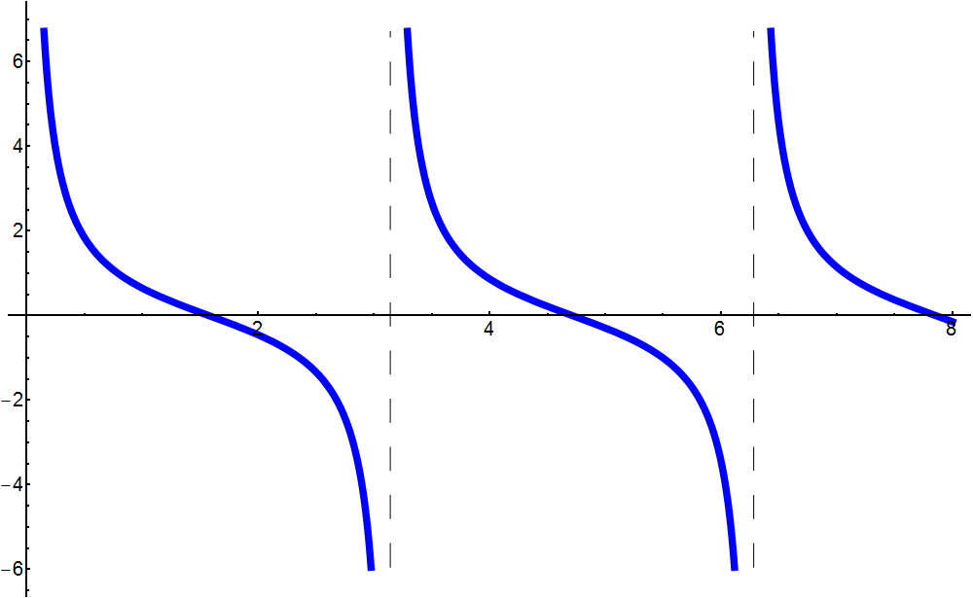
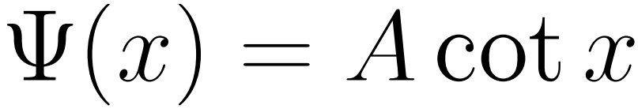
The Wave Function
<number>

Slide 15
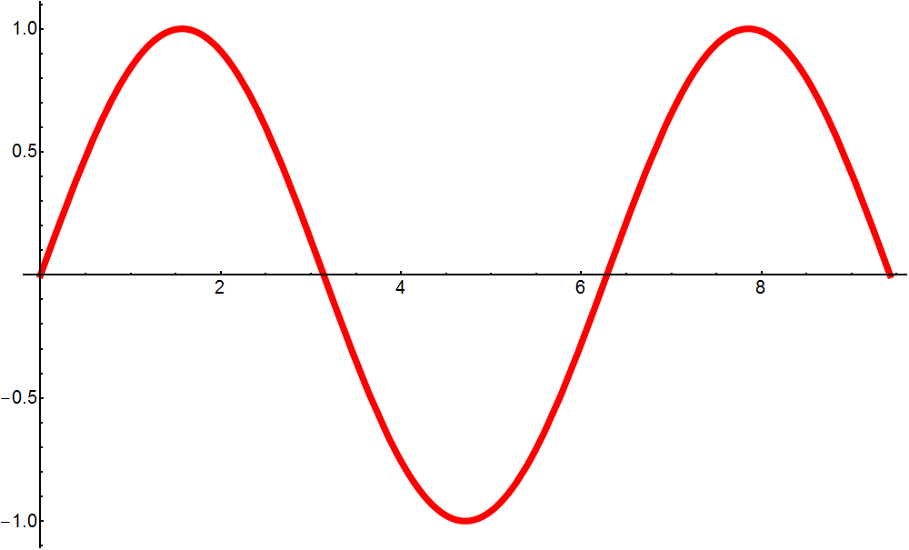
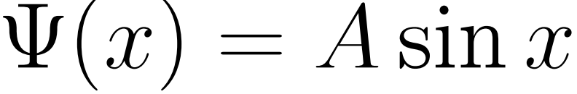
The Wave Function
<number>

Slide 16
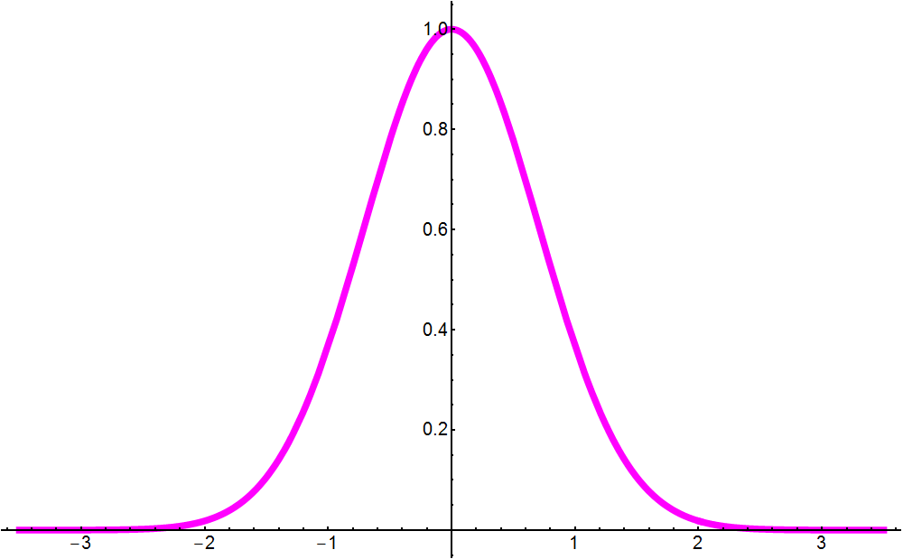
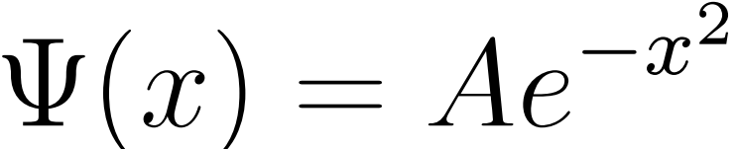
The Wave Function
<number>

Slide 17
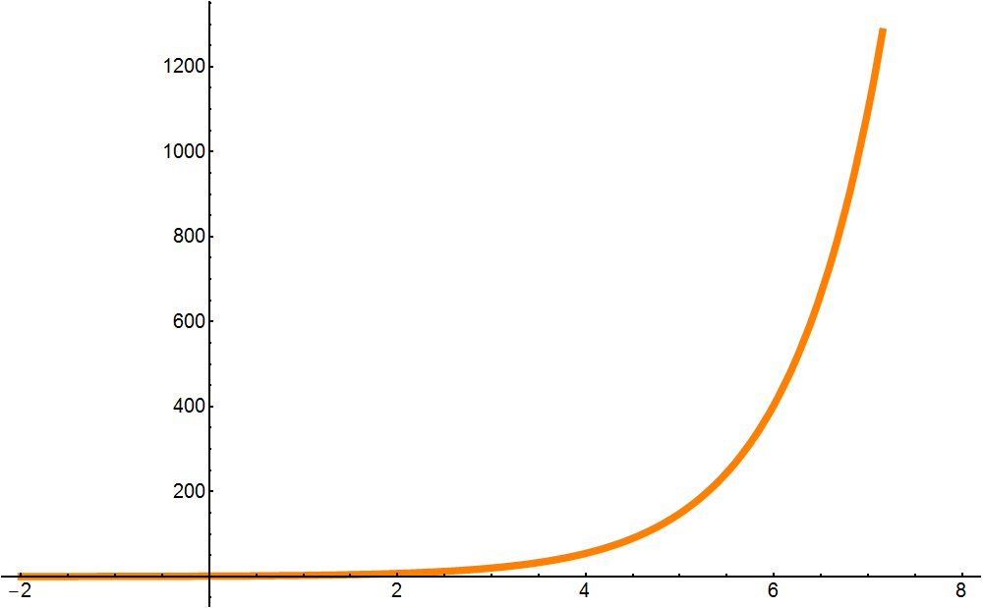
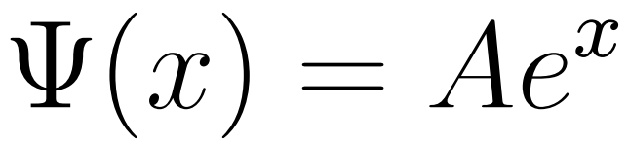
The Wave Function
<number>

Slide 18
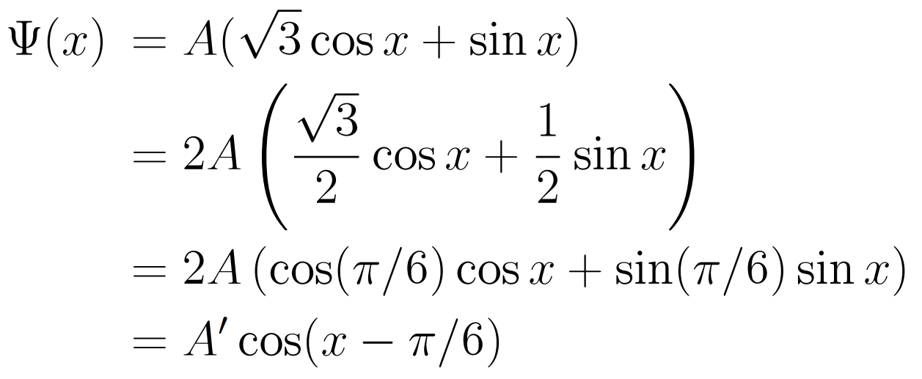
The Wave Function
<number>

Slide 19
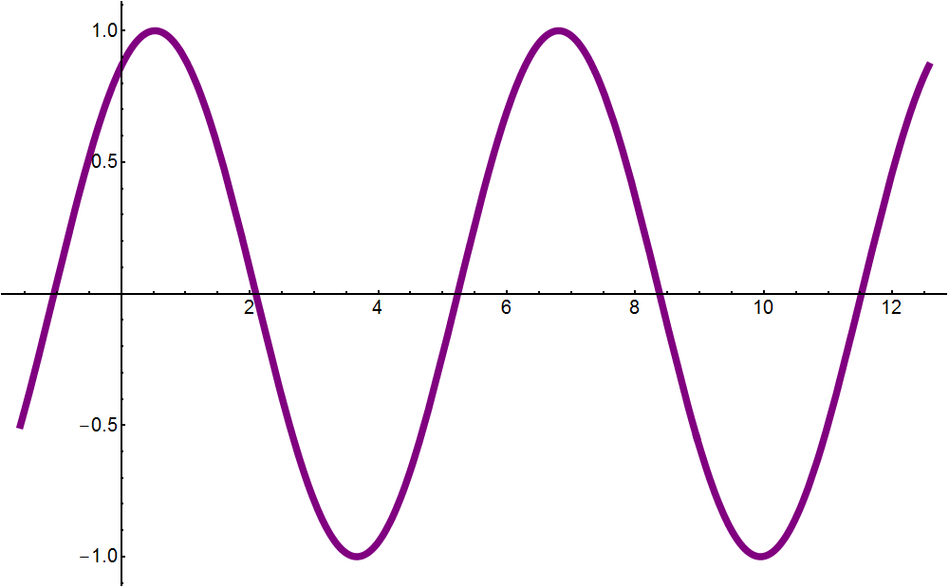

The Wave Function
<number>

Slide 20
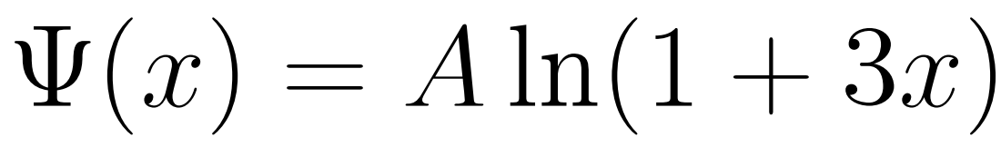
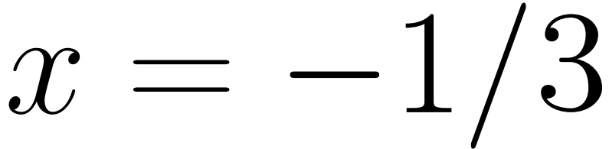
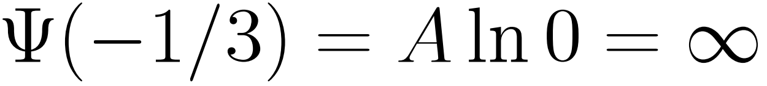
The Wave Function
<number>

Slide 21
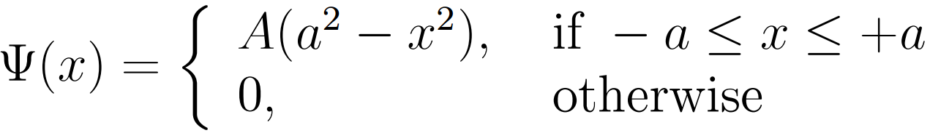
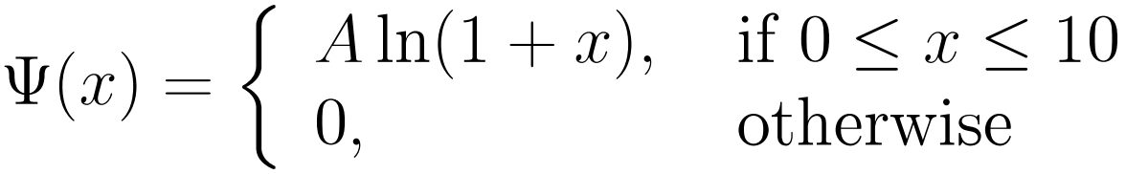
The Wave Function
<number>

Slide 22
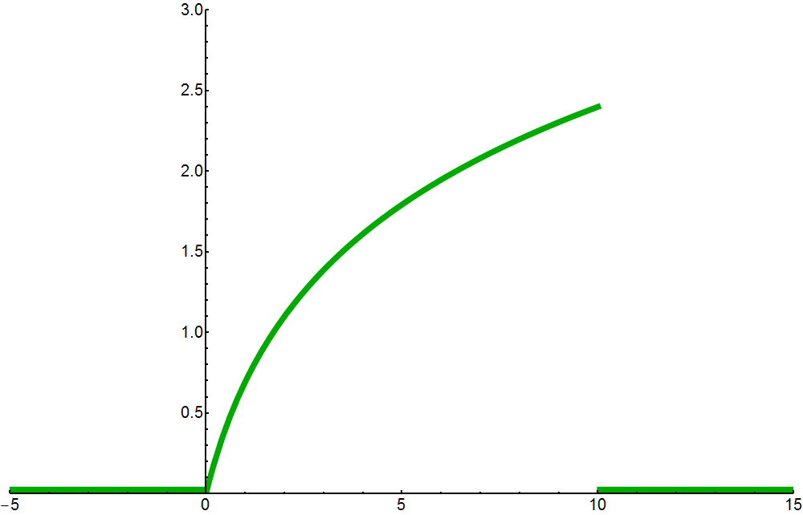
The Wave Function
<number>

Slide 23
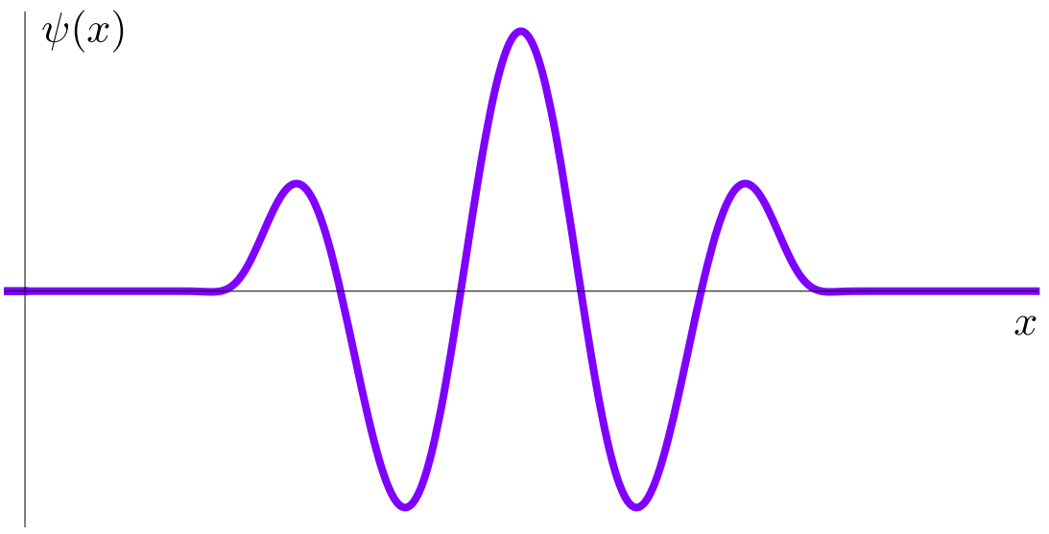
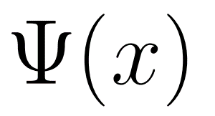
The Wave Function
<number>

Slide 24
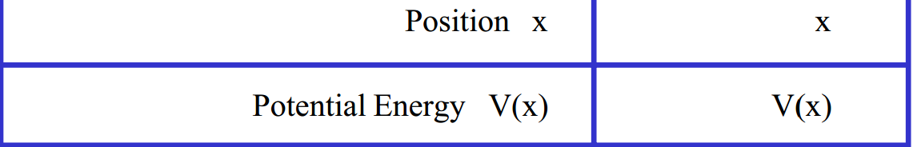
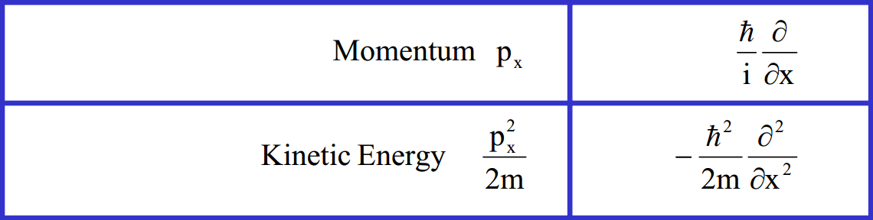
Operators in QM
<number>

Slide 25
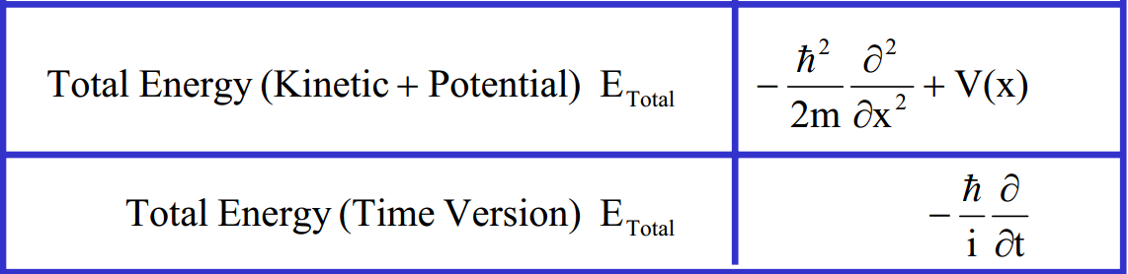
Operators in QM
<number>

Slide 26
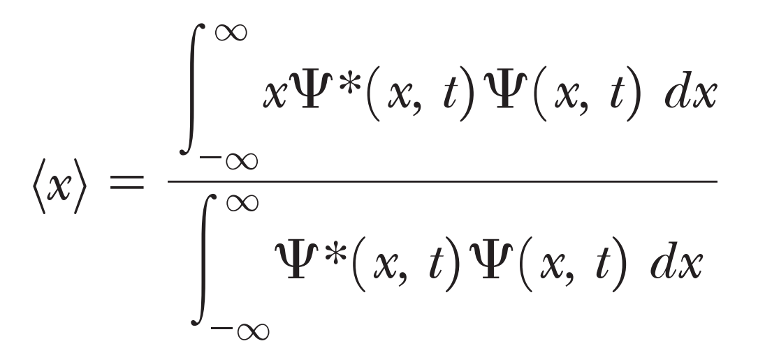
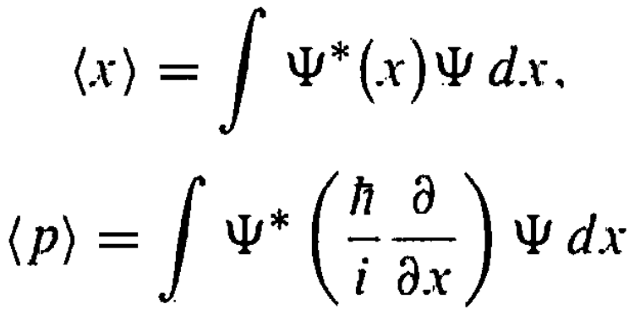
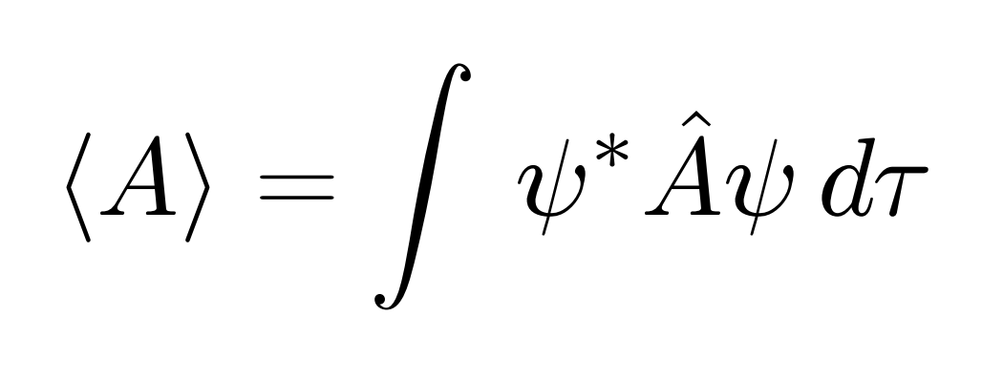
Expectation Value
In quantum mechanics, the expectation value is the average of repeated measurements on an ensemble of identically prepared systems.
<number>

Slide 27
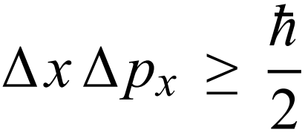
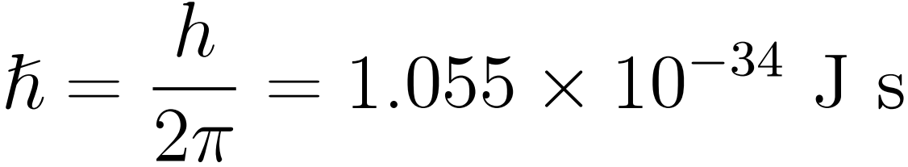
Heisenberg’s Uncertainty Principle
It is impossible to specify simultaneously, with arbitrary precision, both the momentum and the position of a particle.
<number>

Slide 28
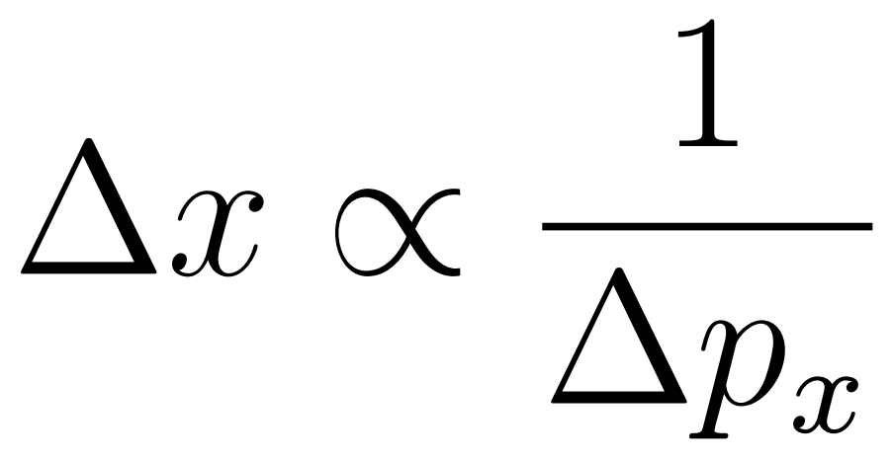
Heisenberg’s Uncertainty Principle
The uncertainty principle restricts the precision with
which complementary observables may be specified
and measured simultaneously.
<number>

Slide 29
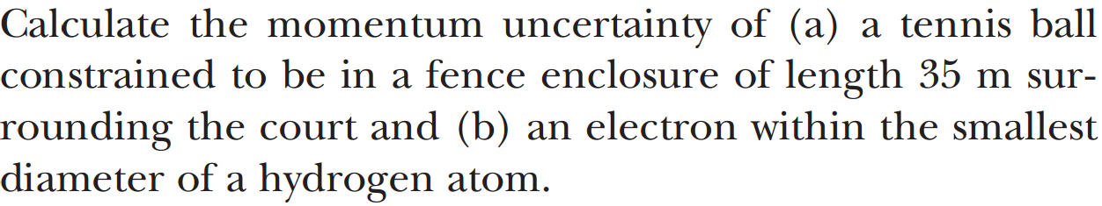
Heisenberg’s Uncertainty Principle
<number>

Slide 30
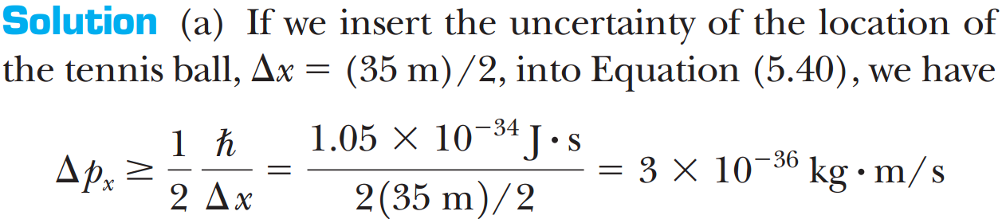
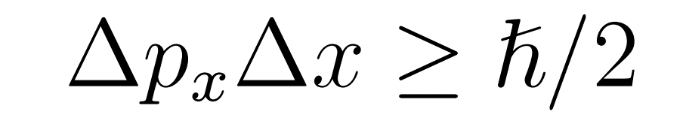
Uncertainty Principle
<number>

Slide 31
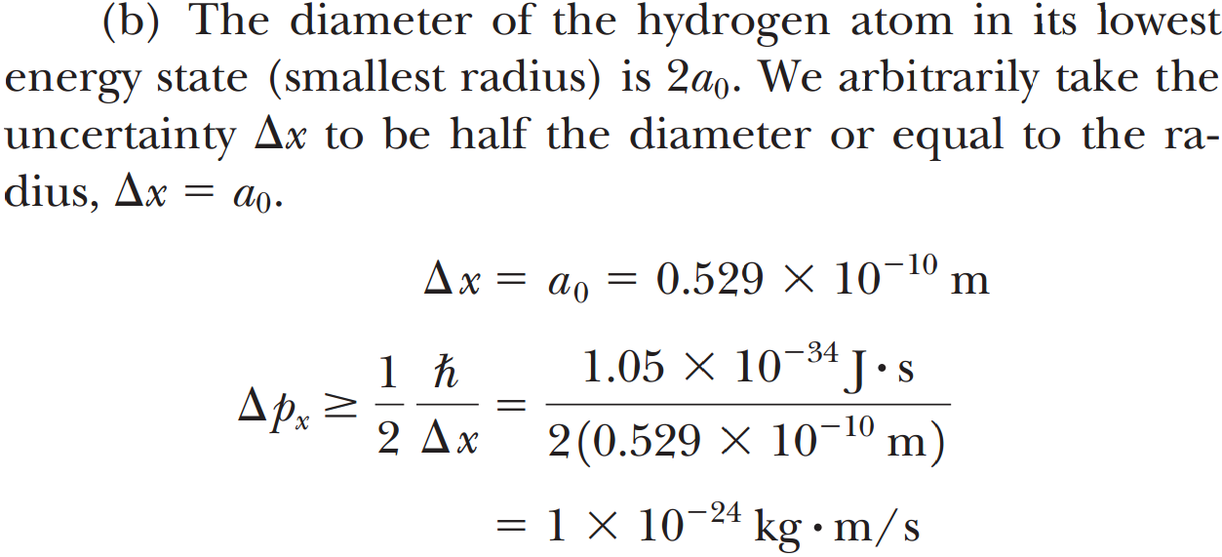
Uncertainty Principle
<number>

Slide 32
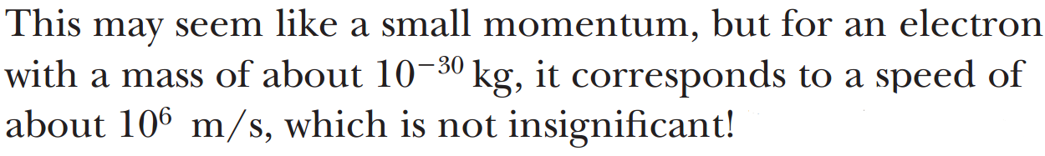
Uncertainty Principle
<number>

Slide 33
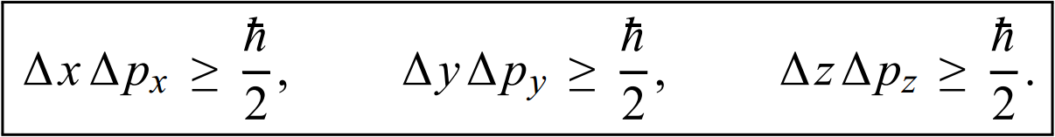
Heisenberg’s Uncertainty Principle
<number>

Slide 34
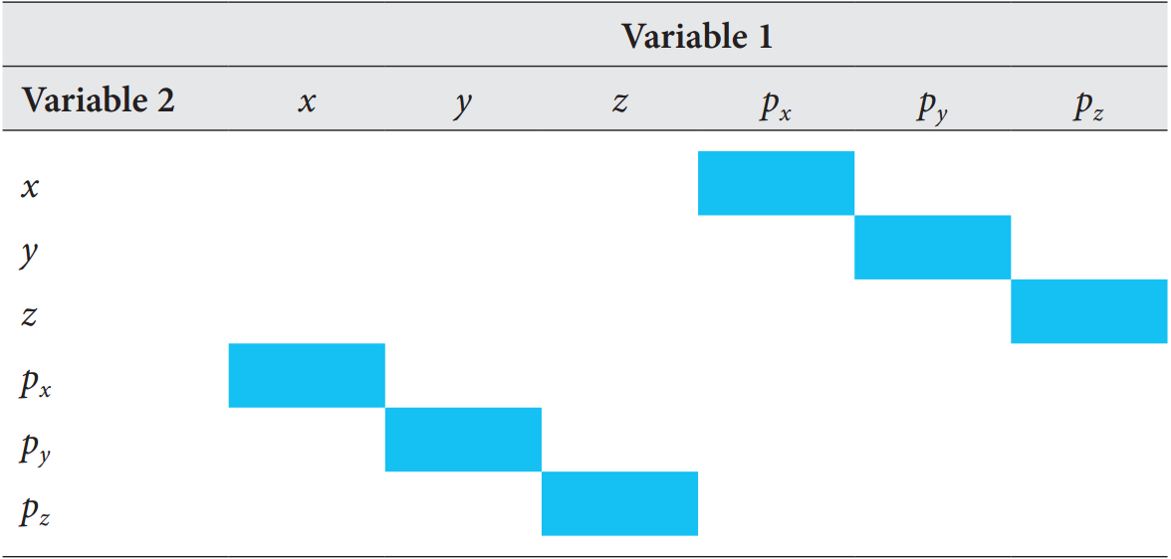
Constraints of the uncertainty principle
<number>

Slide 35
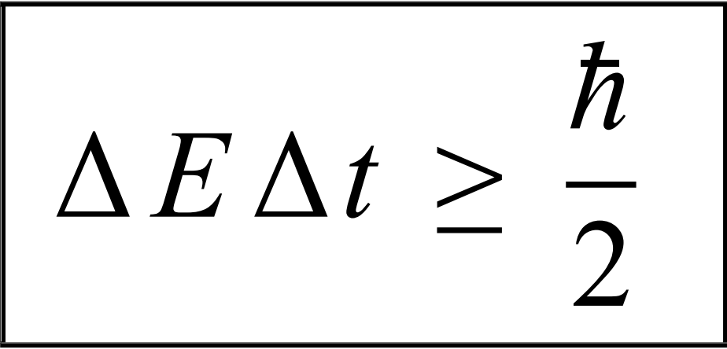
Energy-Time Uncertainty Principle
<number>

Slide 36

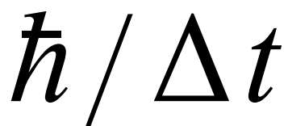
Uncertainty Principle
This relation states that if we make two measurements of the energy of a system and if these measurements are separated by a time interval t, the measured energies will differ by an mount E which can in no way be smaller than . If the time interval between the two measurements is large, the energy difference will be small.
<number>
Notes:
This can be attributed to the fact that, when the first measurement is carried out, the system becomes perturbed and it takes it a long time to return to its initial, unperturbed state.
<number>

Slide 37
Uncertainty Principle
We must emphasize that the uncertainties are intrinsic. They are not due to our inability to construct better measuring equipment. No matter how well we can measure, no matter how accurate an instrument we build, and no matter how long we measure, we can never do any better than the uncertainty principle allows.
<number>

Slide 38





The Postulates of QM
<number>

Slide 39




The Postulates of QM
<number>

Slide 40



The Postulates of QM
<number>

Slide 41




<number>

Slide 42







<number>

Slide 43







<number>
Notes:
<number>

Slide 44



<number>
Notes:
<number>

Slide 45



<number>
Notes:
<number>

Slide 46

<number>
Notes:
<number>

Slide 47
<number>
Notes:
<number>

Slide 48


The expectation value of the position
<number>

Slide 49


The expectation value of the momentum
<number>

Slide 50




The expectation value of the momentum
<number>

Slide 51



The expectation value of the momentum
<number>

Slide 52



The expectation value of the momentum
<number>

Slide 53





<number>

Slide 54


<number>

Slide 55


<number>

Slide 56


<number>

Slide 57




<number>

Slide 58

In physics we say that a given state is degenerate when there is more than one wave function for a given energy.
In our case all three possible wave functions for the first excited state have the same energy. The degeneracy in this case is a result of the symmetry of the cube.
If the box had sides of three different lengths, we say the degeneracy is removed, because the three quantum numbers in different orders (211, 121, 112) would result in three different energies.
<number>

Slide 59


The potential barrier
<number>

Slide 60

<number>

Slide 61

Scanning tunnelling microscopy (STM)
wikipedia.org
<number>

Slide 62


Si & Au as seen in STM
wikipedia.org
<number>

